Slide 1
Women’s History Month
Working to Form a More Perfect Union:
Honoring Women in Public Service and Government

Slide 2
Women’s History Month
Each year, the National Women’s History Project (NWHP) selects a theme that highlights achievements by distinguished women.
This year's theme, Working to Form a More Perfect Union: Honoring Women in Public Service and Government, highlights 16 women who have shaped America’s history and its future through their public service and government leadership.

Slide 3
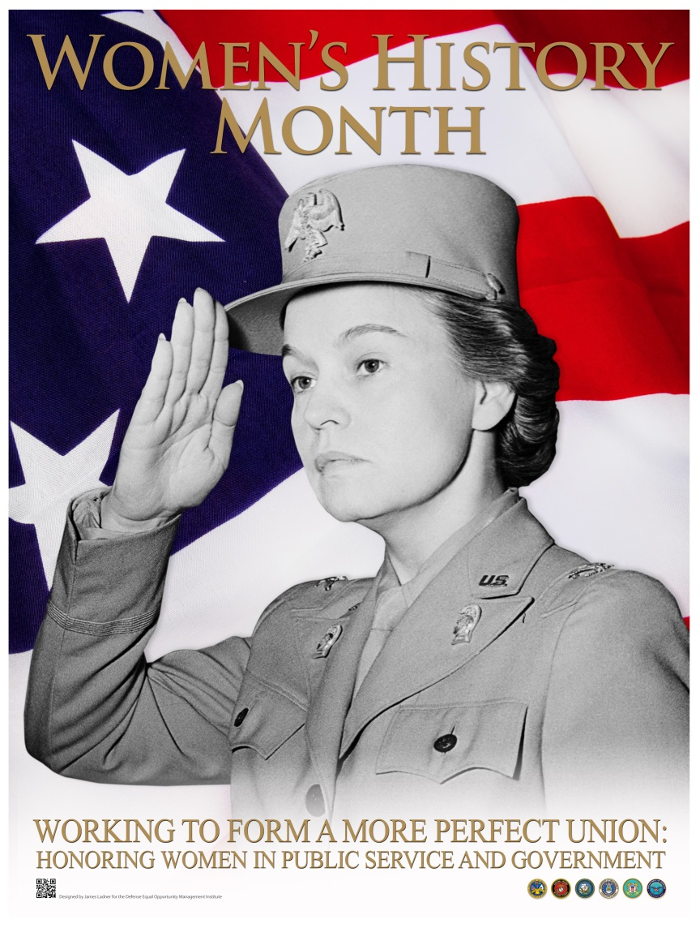
Women’s History Month
This presentation features 2016 Honoree, Colonel Oveta Culp Hobby, a pioneering military leader who helped define women’s initial role in the U.S. Army during World War II.

Slide 4
Women’s History Month
By 1941, as the United States edged closer to entering World War II, men were being drafted for military service—the first peacetime draft in American history.
During that time, as many as 10,000 letters a day poured into the capital from women seeking to support the war effort by whatever means they could.

Slide 5
Women’s History Month
In 1941, General David Searles asked Mrs. Oveta Culp Hobby, the wife of the former governor of Texas, to direct a women’s initiative in support of the Army.
At the time, she served on the Texas State Committee for Human Security, an organization that solicited funds for blind and needy children.

Slide 6
Women’s History Month
Mrs. Hobby declined, stating she could not be away from her family. General Searles then proposed that she outline what such an organization would look like for women who wanted to contribute.
She sent him a proposed organizational chart. He asked her again to serve as Chief of the Women's Interest Section, Bureau of Public Affairs, for the War Department.

Slide 7
Women’s History Month
She refused a second time. When her husband heard about the offer, he told her, “Any thoughtful person knows that we are in this war, and that every one of us is going to have to do whatever we are called on to do.” She then accepted the job.
At a salary of a dollar a year, Mrs. Hobby moved to Washington, D.C. and served in this position for one year before her mandate changed with the country’s declaration of war on December 8, 1941.

Slide 8
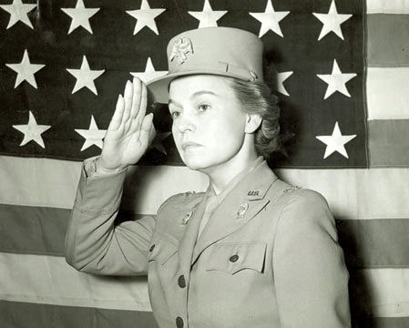
Women’s History Month
In 1942 Major Hobby became the first Director of the newly-formed Women’s Army Auxiliary Corps (WAAC), later renamed the Women’s Army Corps (WAC) in 1943.

Slide 9
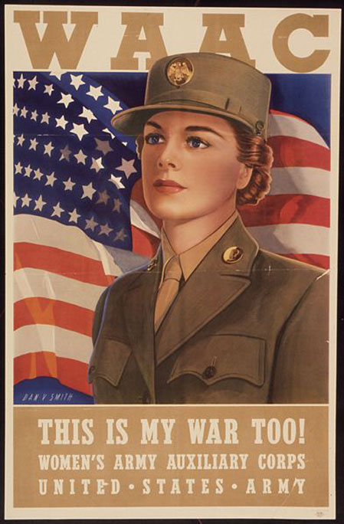
Women’s History Month
At first, Major (later Colonel) Hobby was a one-person recruiting marathon.
She proved herself a masterful speaker, persuading large numbers of women to take the unprecedented step of enlisting.

Slide 10
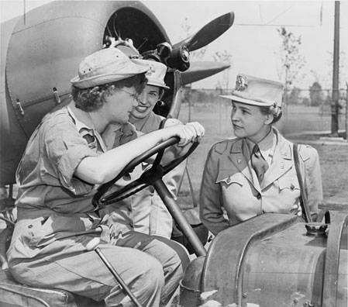
Women’s History Month
During the first year, Major Hobby often had to fight to get resources and recognition for her female soldiers.
Challenging all gender norms, the Corps faced opposition from both the civilian public and exclusively male military.

Slide 11
Women’s History Month
Her job involved a difficult balancing act between concerns that being in the Army seemed unladylike, and fears that women would become a corruptive influence on the male soldiers.
Many commanders were fearful of the effects of fraternization between soldiers and WACs. They went to extraordinary lengths to limit contact—restricting the nights that women were allowed to go out on army bases after hours, or even fencing in the women’s barracks.

Slide 12
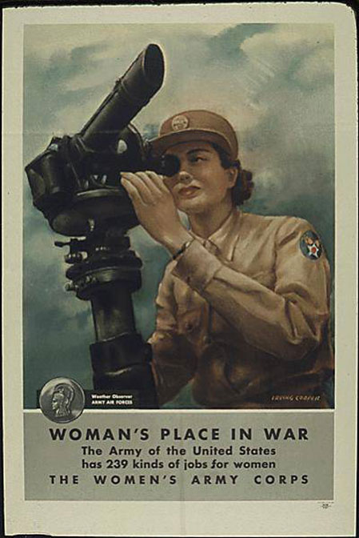
Women’s History Month
In spite of the discrimination they faced, the WACs proved invaluable to the war effort.
By the end of Colonel Hobby’s tenure WACs filled 239 different army positions, more than four times initial estimates.

Slide 13
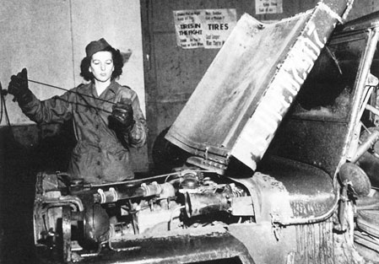
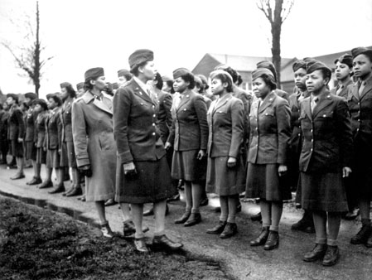
Women’s History Month
Within two years, there were requests for more than 600,000 WACs from around the world, though the strength of the women’s army wasn’t authorized to exceed 200,000.

Slide 14
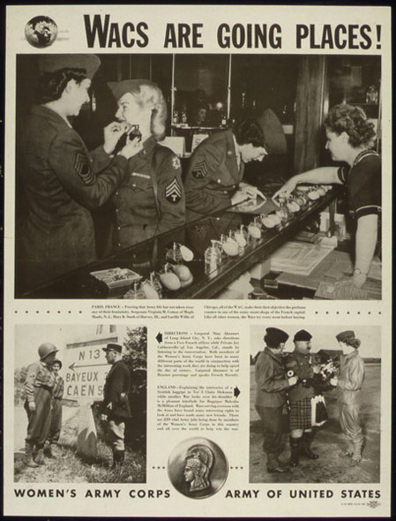
Women’s History Month
Ultimately, WACs were posted in Europe, the South Pacific, and the China-India-Burma theater.
Everywhere they went, they served with distinction, despite the continuing discrimination against them.

Slide 15
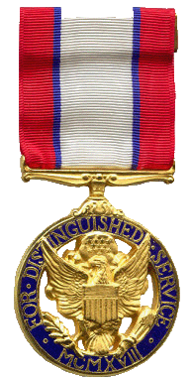
Women’s History Month
In July 1945, with the war in Europe at an end and the Japanese close to surrender, Colonel Hobby resigned her commission.
Colonel Hobby was awarded the Distinguished Service Medal—the first and only—WAC to receive this medal during World War II.

Slide 16
Women’s History Month
As a private citizen, Colonel Hobby served as director of the Houston radio station KPRC (Kotton Port Rail Center) and the new KPRC-TV, and executive vice president of the Houston Post.
When she co-chaired the local Armed Forces Day celebration, she ruffled more than a few feathers when she declared that, “No celebration of Armed Forces Day will be held in Houston which is not open to everyone who has served in our armed forces—regardless of race.”

Slide 17
Women’s History Month
Colonel Hobby’s convictions about diversity were straightforward: “The rule of thumb is a simple one,” she wrote. “Regard each man, each woman, as an individual, not as a Catholic, a Protestant, or a Jew; not as an Indian, American, or European. Like or dislike a person for his own intrinsic qualities—not because he belongs to a different race or subscribes to a different religion. Dignify man with individuality.”

Slide 18
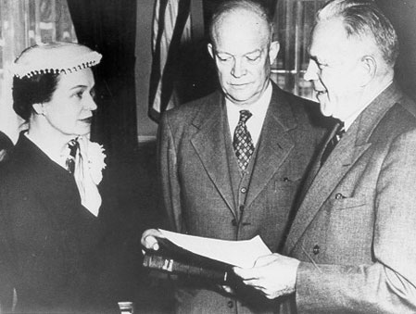
Women’s History Month
In 1953, she was called upon by President Dwight D. Eisenhower to serve as the first Secretary of the Department of Health, Education, and Welfare (HEW), a position that she held until 1955.

Slide 19
Women’s History Month
During her thirty-one-month tenure, she oversaw the introduction of the Salk polio vaccine, a major expansion of the federal hospital and health-care infrastructure, an emergency plan to build new schools to meet the demand created by the postwar baby boom, the development of new forms of medical insurance, and a spurt in the number of people covered by Social Security.

Slide 20
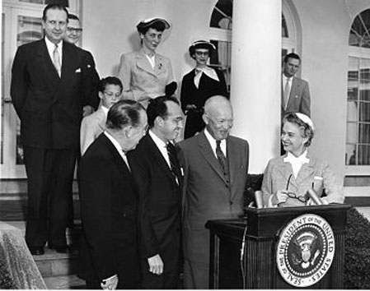
Women’s History Month
A ceremony at the White House Rose Garden in 1955, honoring Dr. Jonas Salk for developing the polio vaccine.

Slide 21
Women’s History Month
In 1978, she was awarded the George Catlett Marshall Medal from the Association of the United States Army for meritorious public service, and the Alumni Association Gold Medal for Distinguished Public Service from Rice University.
In 1996, Colonel Oveta Culp Hobby was inducted into the National Women’s Hall of Fame.

Slide 22
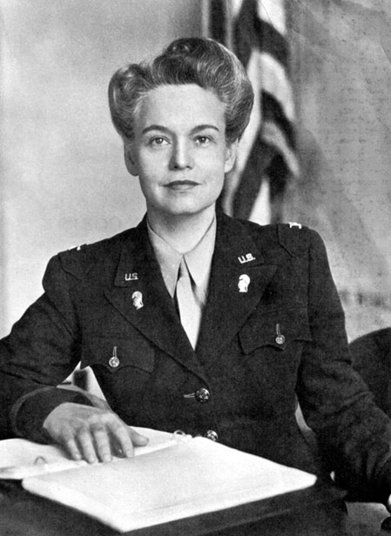
Women’s History Month
Colonel Oveta Culp Hobby died August 16, 1995, at the age of ninety.
She left behind a legacy of service to our country. Her outstanding performance in the offices she held blazed new trails, enabling countless other women to occupy leadership positions that had historically been unattainable.

Slide 23
Women’s History Month
The World War II Memorial in Washington, D.C. includes quotes from war leaders including Presidents Franklin Roosevelt and Harry Truman, Generals Dwight Eisenhower and Douglas MacArthur, and Admiral Chester Nimitz.
The only woman quoted is Colonel Oveta Culp Hobby: “Women who stepped up were measured as citizens of the nation, not as women. This was a people’s war and everyone was in it.”

Slide 24
Women’s History Month
The NWHP 2016 Honorees have dramatically influenced our public policy and the creation of viable institutions and organizations.
From championing basic human rights to ensuring equal access and opportunity for all Americans, they have led the way in establishing a stronger and more democratic country.

Slide 25
Women’s History Month
Each of these brave women succeeded against great odds. Together, their stories demonstrate both the daunting challenges they have faced, and the extraordinary successes they have realized.
The tenacity of each Honoree underlines the fact that women from all cultural backgrounds in all levels of public service and government are essential in the continuing work of forming a more perfect union.

Slide 26
Women’s History Month
Below is a list of other 2016 Honorees
For more information go to www.nwhp.org
Sister Mary Madonna Ashton
Daisy Bates
Sonia Pressman Fuentes
Isabel Gonzalez
Ella Grasso
Suzan Shown Harjo
Barbara Mikulski
Betty Mae Tiger Jumper
Inez Milholland
Karen Narasaki
Nancy Grace Roman
Bernice Sandler
Nadine Smith
Judy Hart
Dorothy C. Stratton

Slide 27
Sources
http://www.nwhp.org/
http://www.awm.lee.army.mil/research_pages/hobby.htm
https://www.ssa.gov/history/hobby.html

Slide 28
Prepared by the Defense Equal Opportunity Management Institute, Patrick Air Force Base, Florida March 2016
Dawn W. Smith
All photographs are public domain and are from various sources as cited.
The findings in this report are not to be construed as an official DEOMI, U.S. military services, or the Department of Defense position, unless designated by other authorized documents.

